Slide 1

HIV/aids deaths in south Africa
2005-2012 dataset

Slide 2
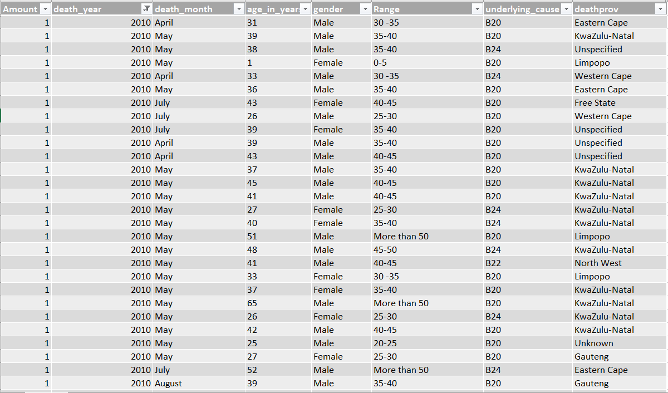

Slide 3
BACKGROUND
The data set used is from Data.code4sa.org, Data set consists of HIV/AIDS causes of Death which includes B20, B21, B22, B23, B24 According with the ICD- 10 code).
(The data reported on is from Year 2005 – 2012
The Visualization was created using Tableau 10.5

Slide 4
BACKGROUND: Questions
HIV/ AIDS have been the major concern in South Africa as it affect all of the 9 provinces in the country. The objective of this project is to understand which province is mostly affected by this disease and what is the underlying cause of deaths. The kind of answers being found out are according to the below questions.
Which province has high number of deaths ?
Which year had high rate of death and what are were the causes ?
What are death rates against gender ?
Which age range is most affected ?

Slide 5
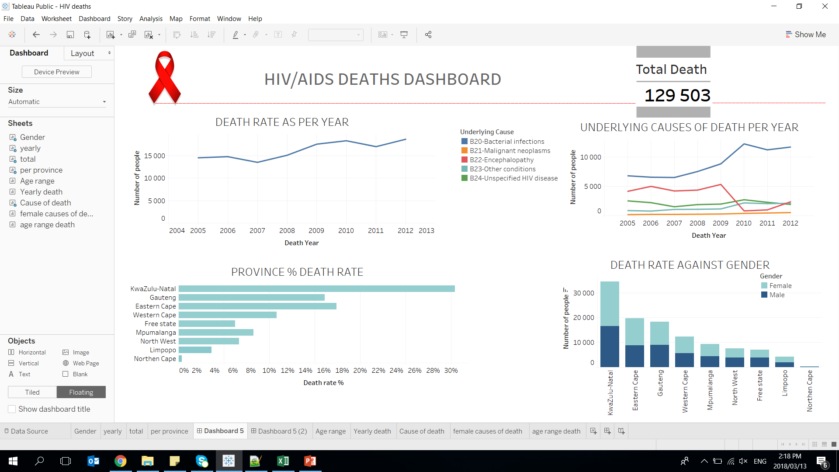

Slide 6
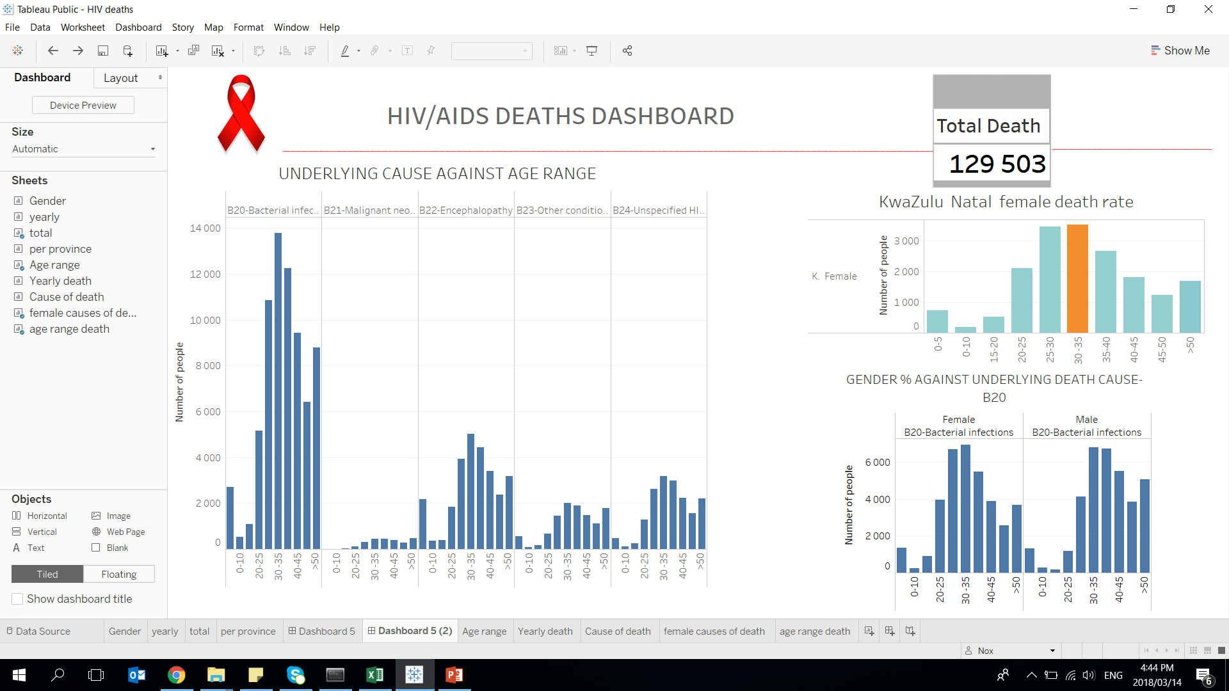

Slide 7
results
From the findings it shows that KZN is majorly affected by HIV/AIDS and more people died with the cause of B20.
As from year 2004 the death rate was lower and the rate rose each year as year 2012 has a higher rate of death.
B20 has a large number of death rate compared to the other underlying causes as B21 shows a very lower rate.
Gender also contributes as the graphs shows that more female death are higher than males.
Most people of age range between 20-29 years and 30-35 years shows a high trend of deaths in the findings.

Slide 8
Tableau work book links
First Dashboard : https://public.tableau.com/profile/nox4104#!/vizhome/HIVdeaths/Dashboard5
Second Dashboard : https://public.tableau.com/profile/nox4104#!/vizhome/HIVdeaths/Dashboard52

